Slide 1
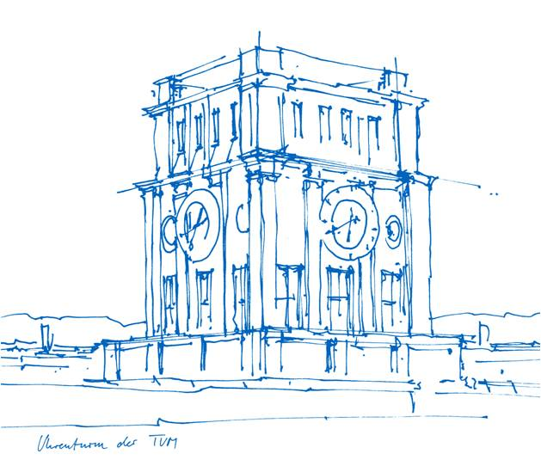
Sensor Nodes Laboratory Presentation
Sebastian Thomas Thekkekara and Nitish Nagesh
August 28, 2019

Slide 2
Overview
Introduction
Block diagram
Read-out circuit
Communication
Data reception
Scaling-up
Conclusion
Sebastian Thekkekara Thomas and Nitish Nagesh | SNL Presentation
2

Slide 3
Introduction
Goal: To develop a fully functional prototype of a wireless sensor node by the end of summer semester 2019
Sub-tasks:
To develop a read-out front-end circuit
To implement a communication interface between the read-out circuit and wireless communication board
To encapsulate the data, send it over a server and visualize it on a terminal
Sebastian Thekkekara Thomas and Nitish Nagesh | SNL Presentation
3

Slide 4
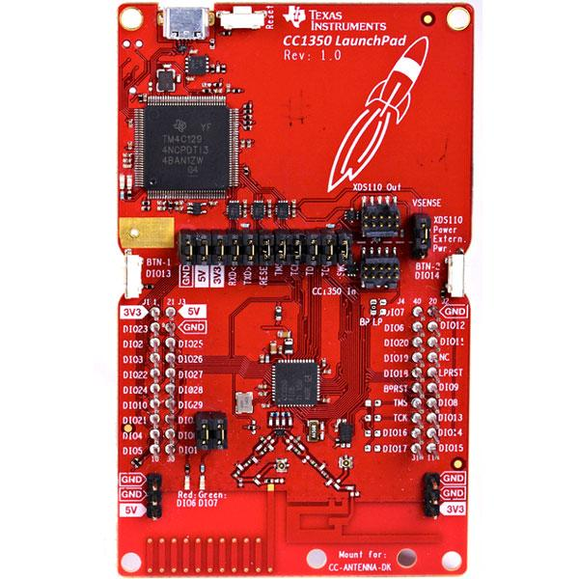
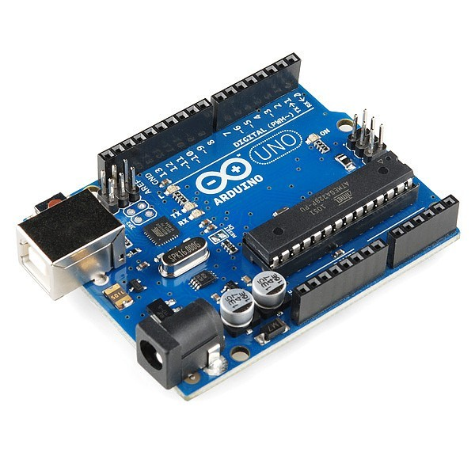
Block Diagram
PSOC
IDAC
Analog Sensor
Sallen Key Filter
Delta Sigma ADC (16 Bit)
UART
Wireless
Gateway
I2C Slave
I2C Master

Slide 5
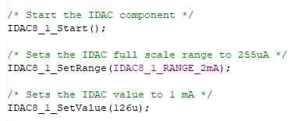
IDAC - Constant Current Source
-50 < T < 200 °C
Current = 1 mA
R_{RTD} = [803.1, 1758.56] Ω
Sebastian Thekkekara Thomas and Nitish Nagesh | SNL Presentation
5

Slide 6
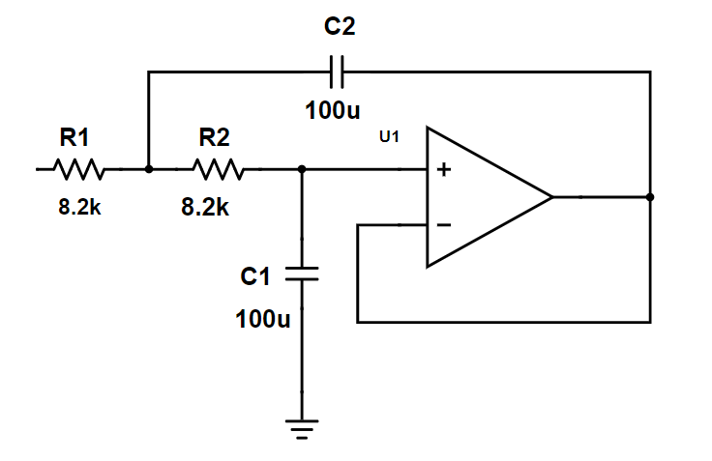
Filter Design
Second Order Sallen Key Low-pass Filter
fc = 0.2 Hz
Q = 0.5
Zeta = 1.0
Source: http://sim.okawa-denshi.jp/en/OPstool.php

Slide 7
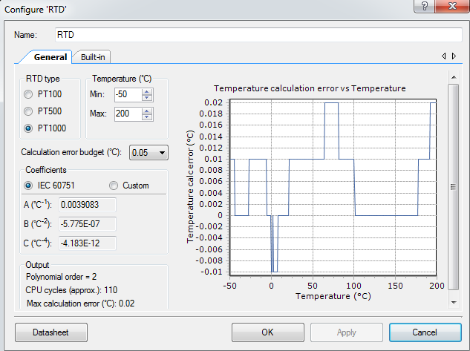
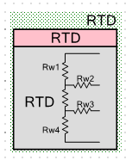
RTD Block

Slide 8
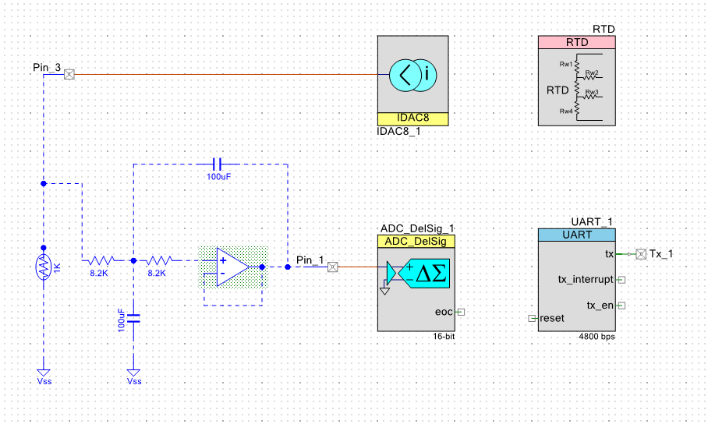
PSoC and Analog Front-End Schematic
Sebastian Thekkekara Thomas and Nitish Nagesh | SNL Presentation
8

Slide 9
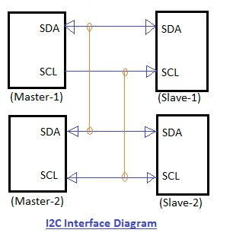
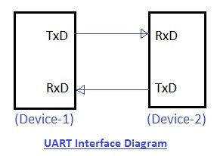
UART vs I2C
Source: https://www.rfwireless-world.com

Slide 10
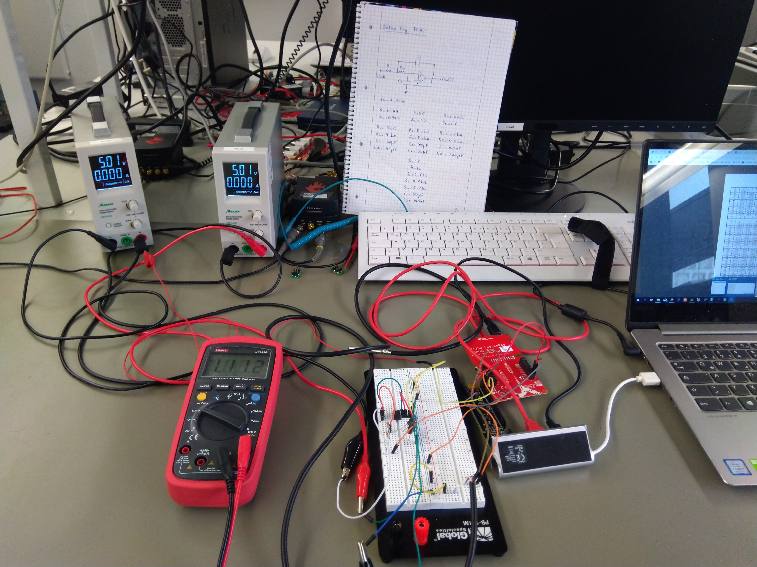
Communication Interface
Regulated DC supply
Launchpad
RTD
Multimeter
PSoC
Filter

Slide 11
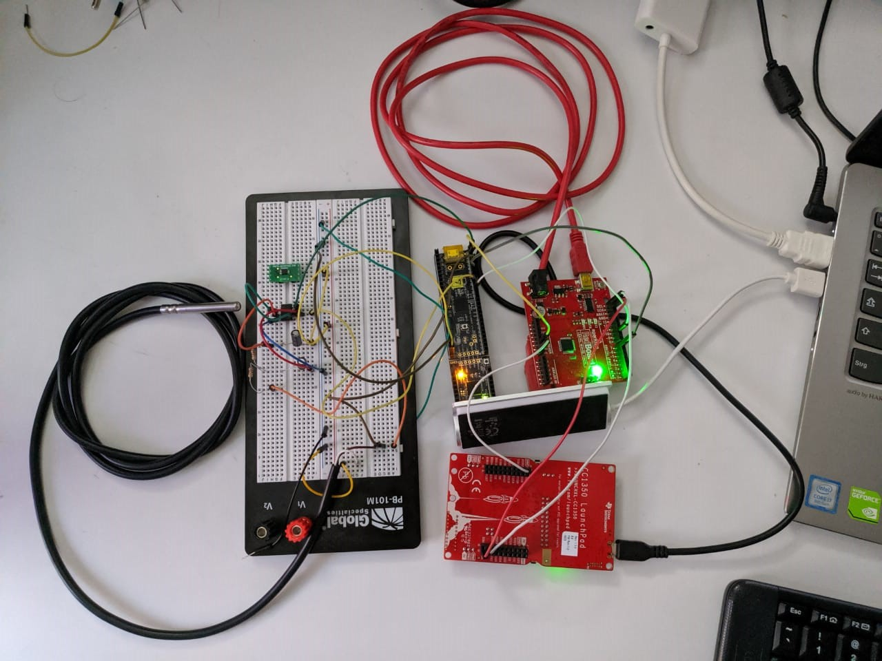
Prototype
Filter
PSoC
Arduino
RTD
Launchpad

Slide 12
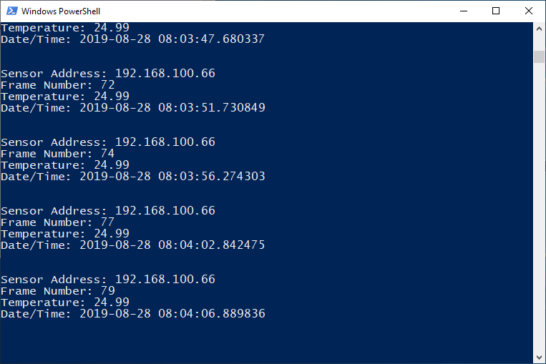
Data Reception

Slide 13
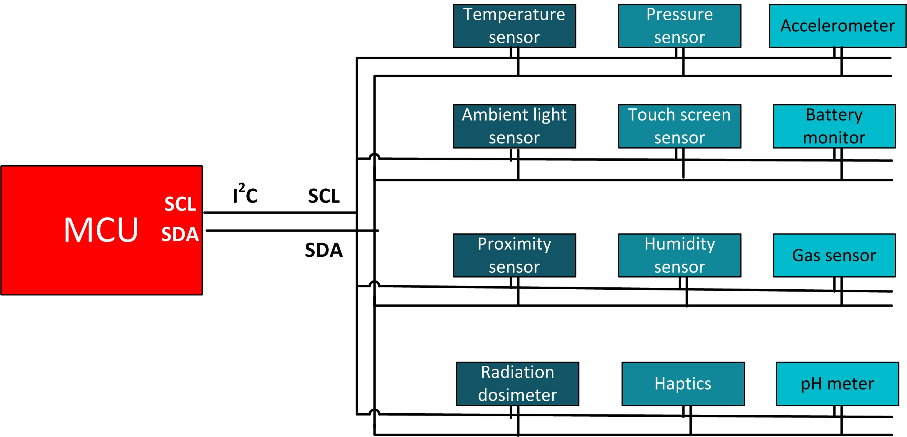
Scaling-up
Single master multiple slaves
Sleep mode when not in use
Data analytics
Source: https://e2e.ti.com/blogs_/b/analogwire

Slide 14
Thank You

